Slide 1
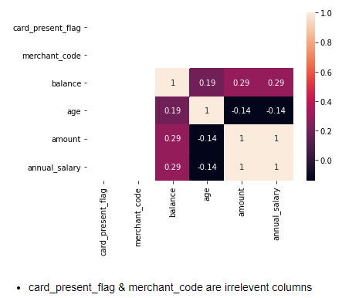
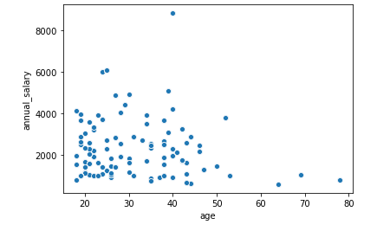
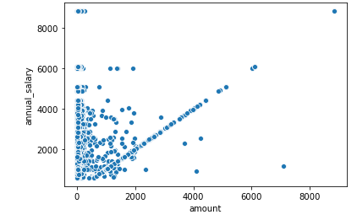
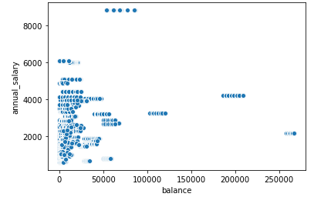
2. We have negative correlation (-0.14) between age and annual salary.
3. We have moderate positive correlation(0.29) between annual salary and balance, By the plot we can infere that some customers whose annual salary lies in 20k to 40k have balance above 1lakhs
We have 100% correlation in amount and annual salary as annual salary is the mean of amount transactions done by customers for pay/salary, those points which are scattered around straight line are transactions done for rest 5 situations.

Slide 2
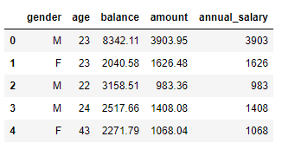
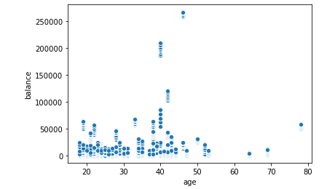
Out of 23 columns, and after performing EDA I found these columns important for predicting salary of the customer.
The customers with age around 40 to 45 have the balance more than 2 lakhs.

Slide 3
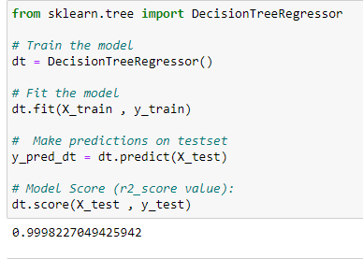
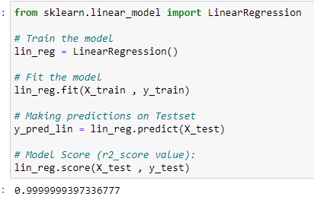
1. By Decision Tree, Model gives r2 value as 0.9998 ie model is 99.98% accurate in predicting salary of customers.
1. By simple Linear regression, model gives r2 value to be 0.9999 ie this model is 99.99% accurate in predicting salary of customers
CONCLUSION: Both the algorithms are giving almost same accuracy, Linear regression may be better as it is simple and efficient and works on principle of y=mc+c, while decision trees are more useful for complex datasets.

